Slide 1

Infectious Disease: Spread and Prevention
Producers: Steven N, Rogelio R, Cristian V, Christian V, and Nate B
Team: LeftMyCar@TheGym
Notes:
Steven -> Rogelio -> Cristian -> Christian -> Nate
The simulation we are talking about today is the infectious disease, how it spreads and how to prevent it

Slide 2
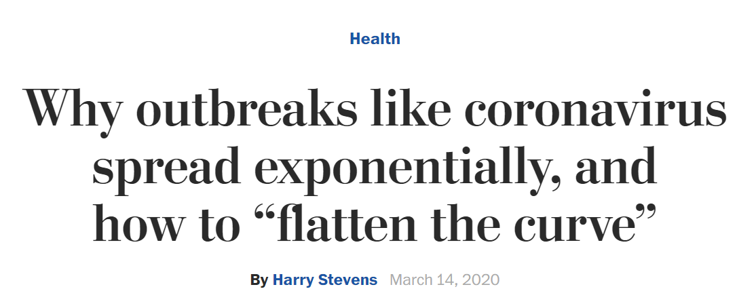
Which Article?
Notes:
The article we use to simulate today call: Why outbreaks like corona virus spread ex’s po-nen-cially, and how to flatten the curve by Harry Steven

Slide 3
Why this Article?
Easy to navigate the topic
Intuitive infectious disease simulation presented on fictitious disease, “Simulitis”
Article’s simulations were representative of 4 likely scenarios
Real life constraints (social distancing) on population flow that present possible real solutions
Notes:
The reason we (chu) choose this article is because
Easy to navigate the topic
Easy to simulate the disease
Article’s simulation were representative of 4 likely scenarios
And more importantly, the article have real life constraints like social distancing on population flow that present possible real solution.

Slide 4
Simulation Techniques
White box Model
Dynamic Model (varies with time)
Stochastic (random actions)
Discrete State, Continuous time Simulation.
Notes:
The techniques we for our simulation are
White box Model
Dynamic Model
Random action
And Discrete State, continuous time simulation

Slide 5
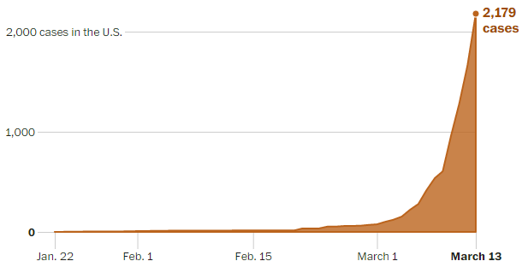
Exponential Growth in Cases of COVID-19
Exponential curve based on doubling of cases every 3 days or so.
Notes:
According to the article, the spread of COVID 19 is ex’s po-nen-cial curve based on doubling the cases by every 3 days or so. Our job is to simulate the disease and add some factors to make the spike flat

Slide 6
Article Simulation (No constraints)
@t = 0 Pop = 200
Sick = 1
Sample is small so we could see the curve steepen greatly, leading to a much larger number infected in larger cities
Notes:
The article runs four simulations to show how the disease is spread. In each of the simulations, there are 200 “people” in an enclosed space. The people move in a random direction initially and will travel in that direction until they collide with a wall or with another person. In the first simulation, there are no constraints on the data. The simulation starts off with 1 person sick and runs until everyone has been infected and recovered.

Slide 7
Attempted Quarantine
Attempting to force Quarantine will work initially, but people will stop complying with time.
Notes:
The second simulations attempts to force quarantine on the 200 people in the confined space. The quarantine is represented by a wall. The wall opens up as time passes to symbolize people breaking quarantine. The quarantine helps to slow the rise of the curve but still resulted in everyone being infected.

Slide 8
Moderate Social Distancing
Constraint added: 75% of the population practices social distancing
Notes:
The third simulation adds the constraint that 75% of the population is practicing social distancing. This is represented by having those practicing social distancing stand still. It helps to flatten the curve of infected at once, peaking at half of the population sick at once.

Slide 9
Extreme Social Distancing
Constraint tightened: 87.5% of population practices social distancing methods that equate to current “shelter in place” methods.
Notes:
The final simulations tightens the constraint of people practicing social distancing to 7/8 of the population. You can see from the gif that there are not nearly as many concurrent sick people at once and a good portion of the population remains healthy at the end.

Slide 10
The Challenge of
Simulation
Accurately modeling real world phenomena while putting in place statistically accurate constraints.
Simulation is like analogy, imperfect but it gets the point across.
Notes:
The challenge of simulation stems from trying to accurately model real world situations while enacting constraints on the data. Simulation isn’t perfect, but it works to get the point across.

Slide 11
Agent-based simulation of a hypothetical disease spread virus
Four parts to this simulation
100x100 grid with 200 people
Simulation repeated 1, 10, 100, and 1000 times to show averages and outliers in data.
People randomly placed in grid
1 infected at t=0.
Notes:
-Cristian: For the second part of our presentation we went with option 2 where we created our own infection simulation. The simulation was done with 4 variations, each adding a specific set of parameters resulting in changes to the data such as average deaths and recovery rate etc. The world we generated uses a 100x100 grid populated by 200 people, with the simulation running for 1, 10, 100, and 1000 iterations to build a decent data set of the averages and identify outliers. People are initialized at random locations on the grid, and we always start the simulation with 1 infected person.

Slide 12


Python Libraries Used
Cristian V,
Random
Pandas
Matplotlib
Notes:
-Cristian: For generating the simulation and plotting the data, we used the Random library for pseudorandom movement generation and grid starting position. Pandas for creating dataframes and calculating the average, and matplotlib for graphing that data, and the simulation was ran using Jupyter notebook.

Slide 13
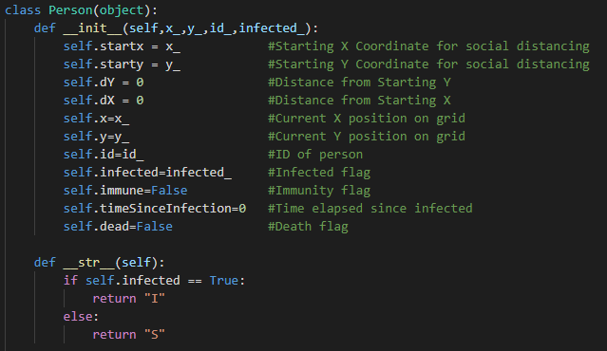
Code Snippet
Person Class
Notes:
-Cristian:We made use of classes to make it easier to keep track of key attributes for every person located on the grid, including their starting position which we assumed as their home; a distance traveled from their home in order to calculate social distancing measures; their current position on grid; and a few flags for later use such as if they are dead, immune to infection, currently infected, and how long its been since they’ve been infected, which is used for later parts incorporating chance of death and recovery.

Slide 14
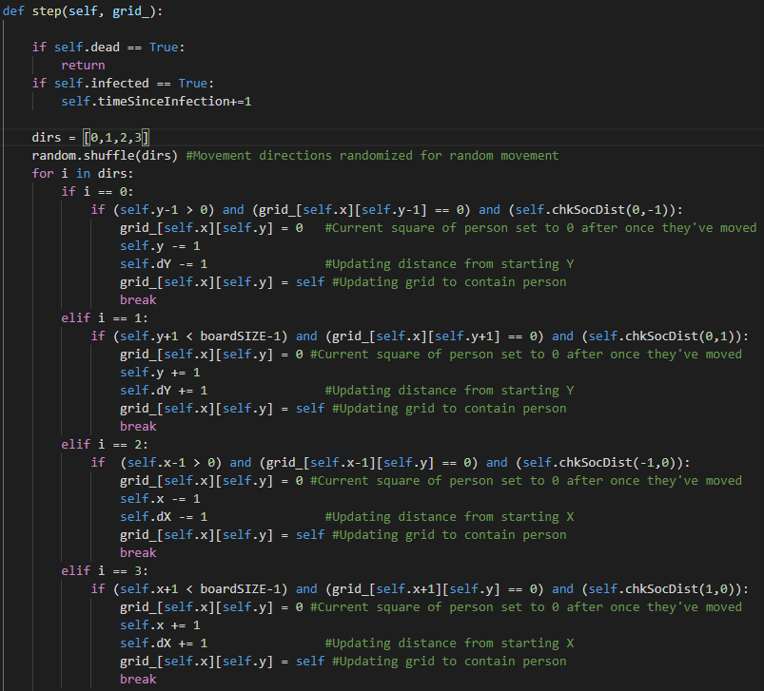
Code Snippet
Step function
Notes:
-Cristian: This section of the code is also part of the person class and determines a persons movement throughout the grid. As the simulation runs, people are allowed random movement throughout the grid with some constraints: They are not allowed to move to a spot where someone else is and they are not allowed to move off the grid. In addition, for simulations B through D recovery and death chance are introduced into the simulation, which affects whether a person is able to move, and obviously they cannot move if they have been flagged as dead. For later parts such as during part D where social distancing is utilized, their movement is limited to a set amount of steps.

Slide 15
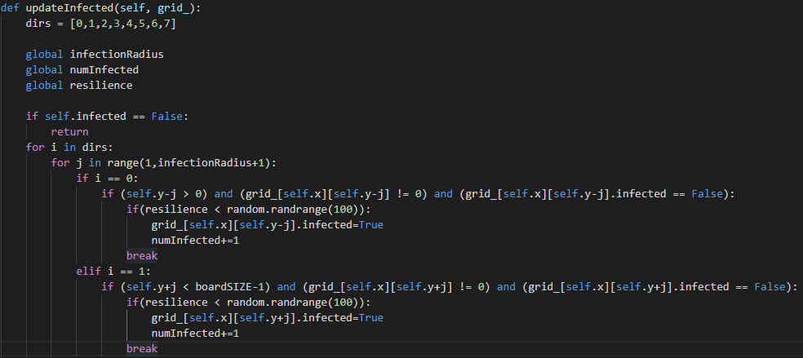
Code Snippet
UpdateInfected function
Notes:
-Cristian: This other section is key to simulating the infection as this function determines if a person is within range of someone infected and evaluates if they contract the virus. For Simulations C and D we adjusted the infection radius in order to observe differences in infection spread. An important note for simulation events A through C is that people have a 100% likelihood of infection if they are within range of someone that’s infected. However, during part D we introduced a resilience variable to simulate the use of masks, hand washing etc, which in turn no longer results in a 100% chance of infection and instead becomes more of a random chance of infection, with a greater reduction due to the resilience factor.

Slide 16
Simulation A
Infection chance = 100%
Infected people infect those immediately adjacent to them
People cannot die or recover.
Simulation runs until everyone is infected
Notes:
-Cristian: For the Simulation A we used a 100x100 grid populated with 200 people, and only 1 infection. Random simulations were generated with varying iterations of 1, 10, 100, and 1000 cycles. The simulation would finish once everyone on the grid became infected. During this people could randomly move throughout the grid with no restrictions and death & recovery percentages were unused.

Slide 17
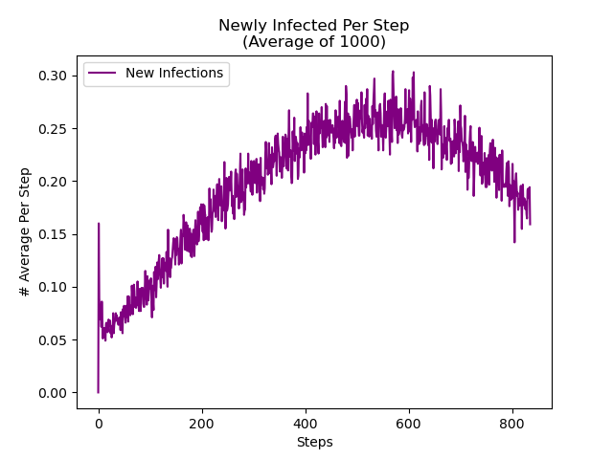
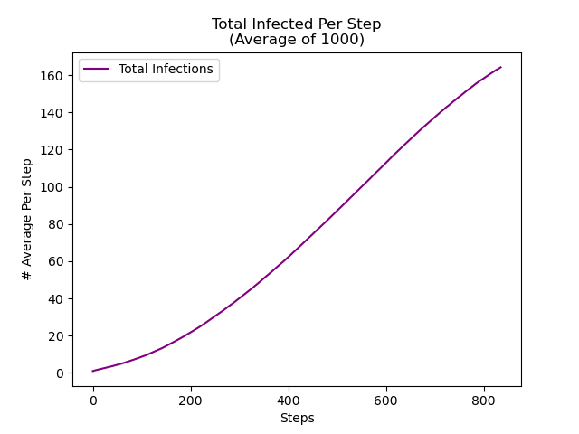
Results of Running Sim A
Notes:
-Cristian: Here we see the results from Simulation A using the 1000 iteration averages for better clarity. The graph on the left is meant to show the number of newly infected people at each step during the simulation until completion. From the lines we can infer that throughout the randomly generated simulations, there is a trend of a higher number of new infections from 400 to 600 steps due to many infected people moving around; and as we get closer towards 1400 steps it starts tapering off and slowing down as most people are infected by this point. Meanwhile, The graph on the right models the total number of people infected people at each step averaged out from the 1000 simulation pass throughs. Since this graph tracks the total number of infected people, and since people cannot die or recover, as each simulation progressed towards the 800 step mark, the graph begins tapering off as most, if not all, of the population is infected by this point.

Slide 18
Simulation B
Infected people now have a 90% chance to recover and a 10% chance to die after 20 time steps.
Other parameters remain the same as Simulation A.
Simulation runs until there are zero infected.
Notes:
Nate: Added a constraint that allows infected people to recover or die off. Other parameters such as the chance to be infected remains the same as in Sim A. Sim B runs until there are zero infected

Slide 19
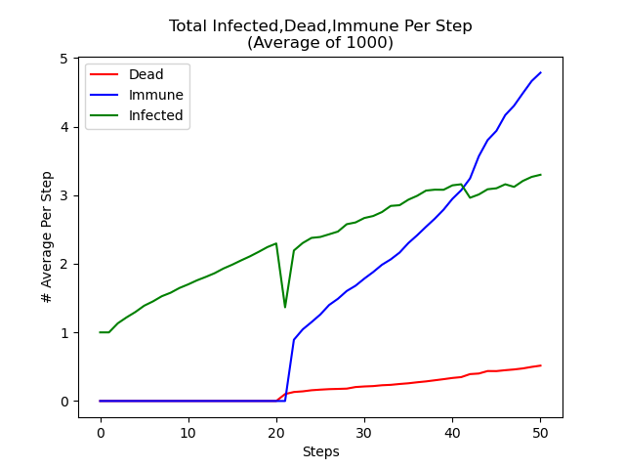
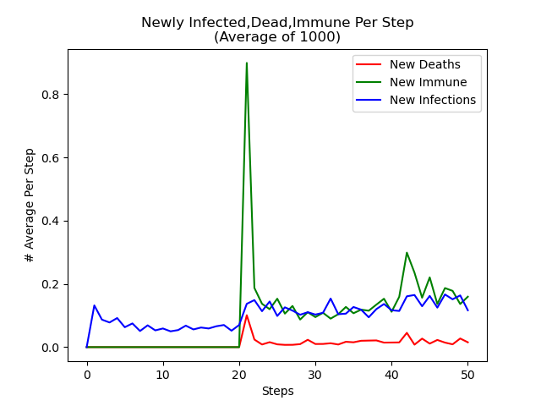
Results of Running Sim B
Notes:
Nate: The first departure from Part A that you’ll notice is a reduced simulation time. This is due to the fact that we are no longer running until ALL are infected but rather only until all those infected are either recovered or have died off. This allows for a more realistic demonstration of the spread of disease, within a closed environment, as people build antibodies or perish.

Slide 20
Simulation C
Infected people now have a 50% chance to recover and a 50% chance to die after 10 time steps.
Infection Radius = 3 instead of 1
Grid Size 50x50 with 100 people
Notes:
WE reduced the population size to 100 in a smaller area of 50x50, allowed an infection radius of 3 compared to the 1 from before, and changed the recovery/death chance to 50/50

Slide 21
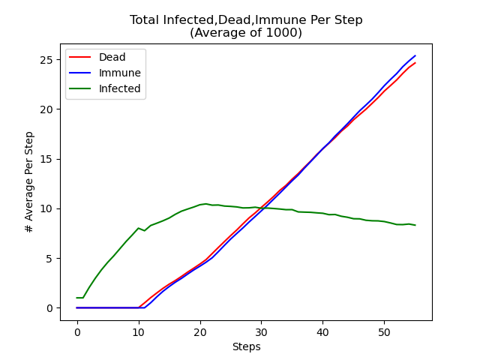
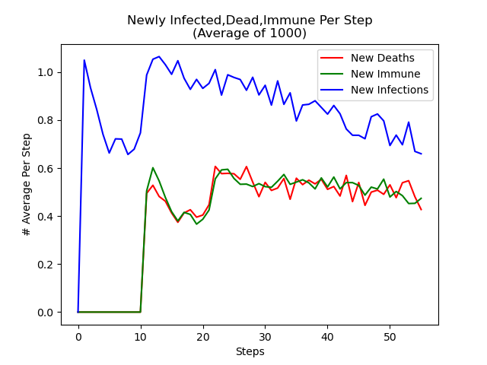
Results of Running Sim C
Notes:
Because of the larger infection radius you we can see there is a larger number of people who are infected at each timestep compared to part B, and the same can be said for the number of people being infected. Although it averages out to one person each step

Slide 22
Simulation D
Using parameters from Simulation B
Resilience to virus added
Social Distancing function added
Wearing masks will increase resilience to virus.
Some people will have higher resilience than others
Notes:
We reverted the parameters to the ones from Simulation B. We also added a social distancing parameter, and a resilience variable. Which should help reduce the spread of the virus

Slide 23
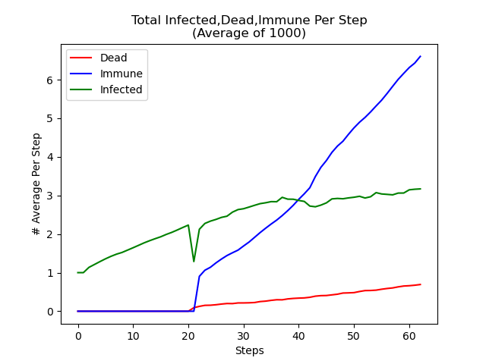
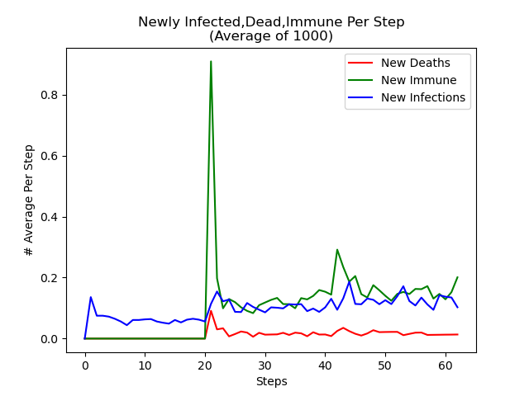
Results of Running Sim D

Slide 24
Adjustable Attributes
Population density
Social distancing/mobility measures
How resilient one is to illness
Preventative measures such as masks and hand washing
Notes:
As we can see from our simulations we can alter some key factors to emulate possible containment methods such as… <List the attributes on slide>. While these attributes are generally on a spectrum, if ordinal, or varied, if nominal, our variables were implemented, almost exclusively, in a binary fashion. They were mostly flags or switches, either on or off. There are also a multitude of other factors, aside from the ones we’ve listed, that we may consider as well.

Slide 25
Us and Them
Handling of Social Distancing
Sample Size
Expertise
White Box Model
Differences in Simulations
Notes:
Article uses an absolute, zero movement or shelter in place model vs our limited range of mobility model Range of motion of the article’s simulated people is 360 degrees while ours is limited to the four primary directions of 2d space. We populated our 10,000 square unit grid with 200 ppl, this equates to just a 2% population density whereas the article’s population is much more dense. Also factored in resistance to infection with an ordinal resilience variable modeled as a percentage to represent things like age differences, mask wearing, hand washing, etc.
With little to.. well.. no expertise, we have developed a crude white box model where variables and their relations to each other are acutely transparent while simulated time is a construct and only generally comparative to real time. By that I mean we can only speak to time qualitatively in the general sense, such as quickly or slowly. We suspect the article’s methods are the same, given that a random number generator does nothing to obfuscate the relation between the simulation and its dependencies

Slide 26
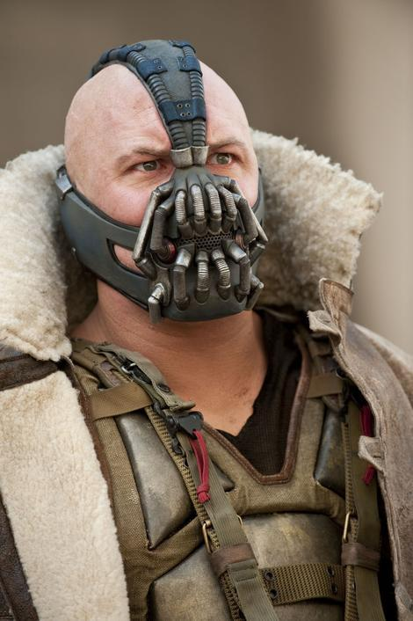
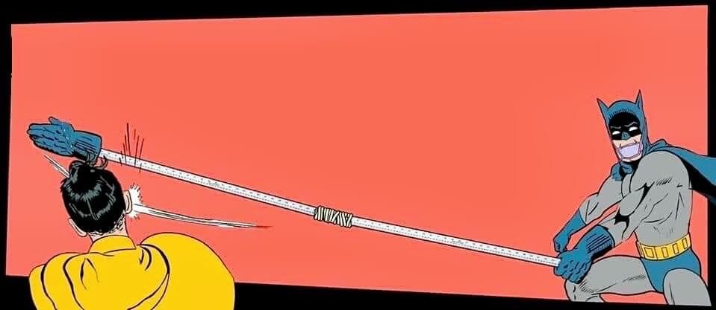
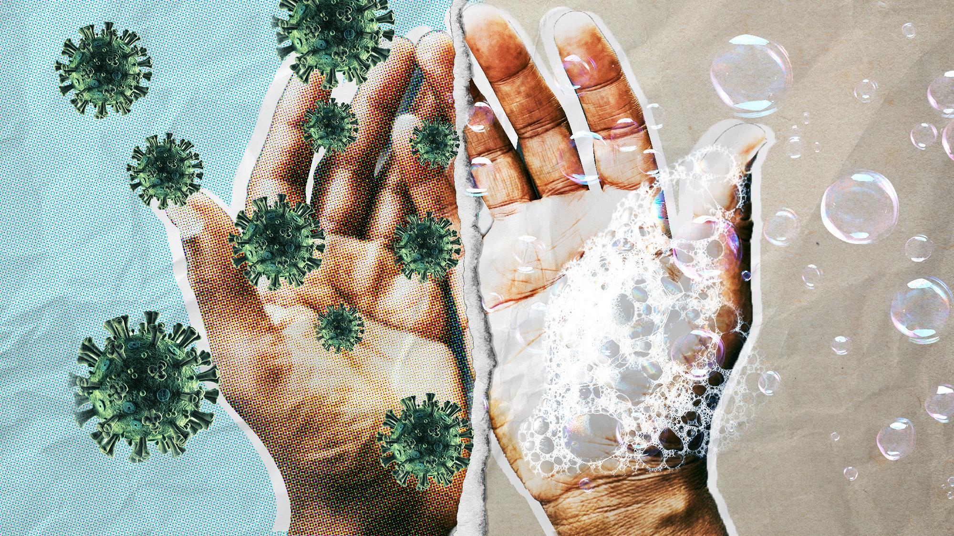
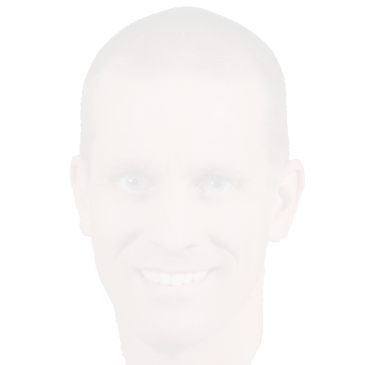
What has this simulation taught us?
What we learned
Socially Distance
Wear a mask and wash your hands.
Disease spreads in direct proportion to population density
Disease can spread quickly if no preventative measures are in place
Notes:
Nate: <Read slide>

Slide 27
If you have any question about the code, feel free to ask it on stackoverflow
THANK YOU ;)
Notes:
Nate: Thank you all for listening to our presentation. Any questions?

